Slide 1
CPE 221: Computer Organization
08 ARM Machine Language
rahul.bhadani@uah.edu

Slide 2
Machine Language
Good design demands good compromise

Slide 3
Data-processing Instructions
32-bit instruction
31:28 | 27:26 | 25:20 | 19:16 | 15:12 | 11:0
cond | op | funct | Rn | Rd | Src2
4 bits | 2 bits | 6 bits | 4 bits | 4 bits | 12 bits
Rd = Register Destination
Source Register
Conditional Execution Code
Op = Operation Code
Funct = Function Code
Source Register

Slide 4
Data-processing Instructions: Functional Code
31:28 | 27:26 | 25:20 | 19:16 | 15:12 | 11:0
cond | op | funct | Rn | Rd | Src2
4 bits | 2 bits | 6 bits | 4 bits | 4 bits | 12 bits
I | cmd | S
I = 1 when Src2 is an immediate
S= 1 when an instruction sets the condition flags
Specific data-processing instruction

Slide 5
Data-processing Instructions: Second Source
imm8 = 8-bit immediate
rot = 4-bit rotation
imm8 is rotated right by 2 x rot to create a 32-bit constant
cond | op | funct | Rn | Rd | Src2
shamt5 = a constant by which the register Rm is shifted
11:8 | 7:0
rot | imm8
Immediate, I = 1
Rs = a register by which the register Rm is shifted
11:7 | 6:5 |  | 4 | 3:0
shamt5 | sh |  | 0 | Rm
Register, I = 0
sh = encodes the type of shift to perform (LSL, LSR, ASR, ROR)
11:8 | 7 |  | 6:5 | 4 | 3:0
Rs | 0 |  | sh | 1 | Rm
Register-shifted Register, I = 0

Slide 6
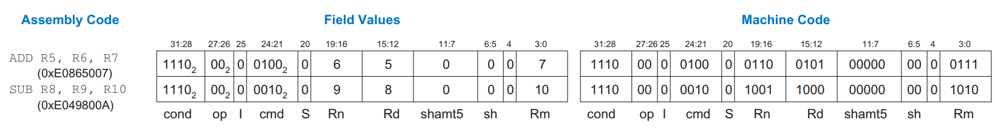
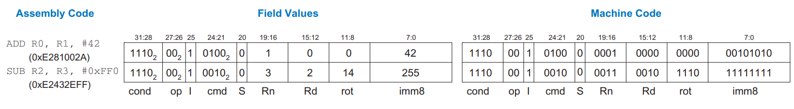
Example Assembly Code for ADD and SUB
Hex is used for compact representation of the Assembly Code.

Slide 7
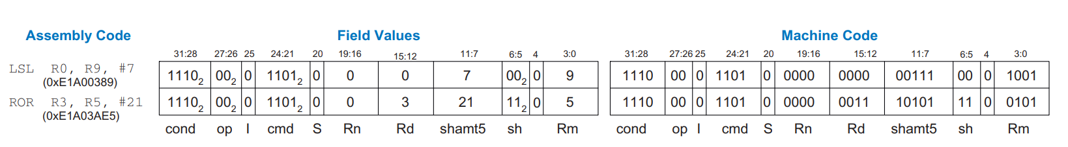
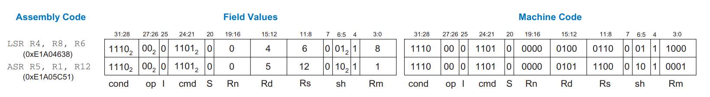
Example Assembly Code for Shift Instruction

Slide 8
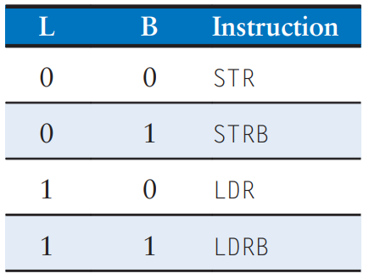
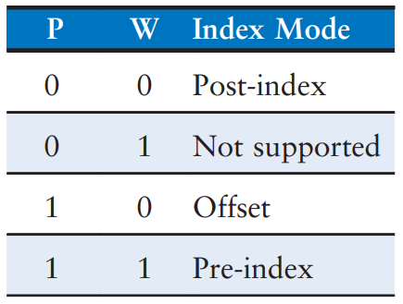
Memory Instructions
11:7 | 6:5 |  | 4 | 3:0
shamt5 | sh |  | 1 | Rm
31:28 | 27:26 | 25 | 24 | 23 | 22 | 21 | 20 | 19:16 | 15:12 | 11:0
cond | op | I | P | U | B | W | L | Rn | Rd | Src2
Function Operation
I = Immediate
P = Pre-index
U = Add
W = Writeback
L = Load
B = Byte
Note: Book is using I bar ( I ) instead I

Slide 9

STR, a Memory Instruction in Machine Code
STR R11, [R5], #-26
Post-indexing: P = 0, W = 0.
Immediate offset is subtracted from the base. So I = 0, U = 0.

Slide 10
Branch Instruction
24-bit signed immediate.
Branch-instruct:
4-bit condition flag, 2-bit op code, 2-bit function code
31:28 | 27:26 | 25:24 | 23:0
cond | op = 10 | 1L | imm24
L = 1 for BL
L = 0 for B
In 2’s complement, used to specify an instruction address relative to PC + 8.

Slide 11
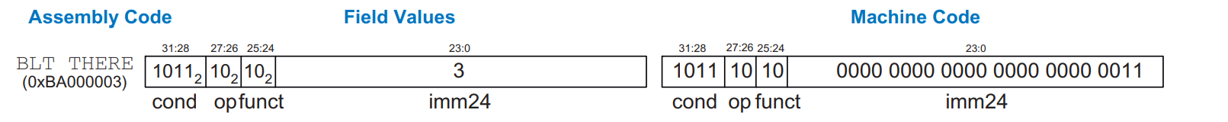
Example of Machine Code for Branch Instruction
0x80A0 BLT THERE
0x80A4 ADD R0, R1, R2
0x80A8 SUB R0, R0, R9
0x80AC ADD SP, SP, #8
0x80B0 MOV PC, LR
0x80B4 THERE SUB R0, R0, #1
0x80B8 ADD R3, R3, #0x5
BTA = Branch Target Address, the instruction address to be executed when the branch is taken. BLT has BTA of 0x80B4, the instruction address of THERE.
24-bit immediate field gives the number of instructions between the BTA and PC+8 (two instructions past the branch)
imm24 here is 3, as BTA is three instructions past PC + 8 (0x80A8).
The processor calculates BTA from the instruction by sign-extending the 24-bit immediate, shifting it left 2 (to convert word to bytes) and adding it to PC-8. (Why 8?, Due to pipelining, the PC points to two instructions ahead of the current instruction, we will see this later)
If the immediate is 101010101010101010101010 (24 bits), sign-extending it would result in 111111111010101010101010 (32 bits) if it's negative.

Slide 12
Addressing Mode
ARM uses 4 types of addressing modes:
Register
Immediate
Base
Program Counter (PC)-relative addressing
Used by data-processing instructions
modes of reading and writing operands
Used by memory instructions
modes of writing the program counter
branches use PC-relative addressing

Slide 13
Quick tips about deciphering machine code
If the op code is 00, it is a data-processing instruction
If the op code is 01, it is a memory instruction
If the op code is 10, it is a branch instruction

Slide 14
Stored Program Concept
Instructions are stored in the memory - hence the Stored Program Concept.
Stored Program offers general purpose computing, can execute multitude of applications.
Instructions in a stored programs are retrieved or fetched from memory and executed by the processor.
Processor fetches the instructions from memory sequentially, fetched instructions are decoded and executed by the digital hardware.
The address of the current instruction is kept in a 32-bit register known as the program counter.
A read to the PC returns the address of the current instruction plus 8.

